Slide 1
Assembly Language for x86 Processors 7th Edition
Kip R. Irvine
Chapter 9: Strings and Arrays
Slide show prepared by the author
Revised by Zuoliu Ding at Fullerton College, 09/2014
(c) Pearson Education, 2015. All rights reserved. You may modify and copy this slide show for your personal use, or for use in the classroom, as long as this copyright statement, the author's name, and the title are not changed.

Slide 2
Chapter Overview
String Primitive Instructions
Selected String Procedures
Two-Dimensional Arrays
Searching and Sorting Integer Arrays
Java Bytecodes: String Processing (optional topic)
Irvine, Kip R. Assembly Language for x86 Processors 7/e, 2015.

Slide 3
String Primitive Instructions
MOVSB, MOVSW, and MOVSD
CMPSB, CMPSW, and CMPSD
SCASB, SCASW, and SCASD
STOSB, STOSW, and STOSD
LODSB, LODSW, and LODSD
Irvine, Kip R. Assembly Language for x86 Processors 7/e, 2015.

Slide 4
MOVSB, MOVSW, and MOVSD (1 of 2)
The MOVSB, MOVSW, and MOVSD instructions copy data from the memory location pointed to by ESI to the memory location pointed to by EDI.
.data
source DWORD 0FFFFFFFFh
target DWORD ?
.code
mov esi,OFFSET source
mov edi,OFFSET target
movsd
Irvine, Kip R. Assembly Language for x86 Processors 7/e, 2015.

Slide 5
MOVSB, MOVSW, and MOVSD (2 of 2)
ESI and EDI are automatically incremented or decremented:
  MOVSB increments/decrements by 1
  MOVSW increments/decrements by 2
  MOVSD increments/decrements by 4
Irvine, Kip R. Assembly Language for x86 Processors 7/e, 2015.

Slide 6
Direction Flag
The Direction flag controls the incrementing or decrementing of ESI and EDI.
  DF = clear (0): increment ESI and EDI
  DF = set (1): decrement ESI and EDI
The Direction flag can be explicitly changed using the CLD and STD instructions:
CLD ; clear Direction flag
STD ; set Direction flag
Irvine, Kip R. Assembly Language for x86 Processors 7/e, 2015.
Notes:
Cờ DF =0 sẽ tăng esi và edi =1 sẽ giảm

Slide 7
Using a Repeat Prefix
REP (a repeat prefix) can be inserted just before MOVSB, MOVSW, or MOVSD.
ECX controls the number of repetitions
Example: Copy 20 doublewords from source to target
.data
source DWORD 20 DUP(?)
target DWORD 20 DUP(?)
.code
cld ; direction = forward
mov ecx,LENGTHOF source ; set REP counter
mov esi,OFFSET source
mov edi,OFFSET target
rep movsd
Irvine, Kip R. Assembly Language for x86 Processors 7/e, 2015.
Notes:
Lặp lệnh movsd sử dụng rep, số lần lặp trong ecx

Slide 8
Your turn . . .
Use MOVSD to delete the first element of the following doubleword array. All subsequent array values must be moved one position forward toward the beginning of the array:
  array DWORD 1,1,2,3,4,5,6,7,8,9,10
.code
cld
mov ecx,(LENGTHOF array) - 1
mov esi,OFFSET array+4
mov edi,OFFSET array
rep movsd
Q: How to delete an element at a specified position?
How to insert an element at a specified position?
Irvine, Kip R. Assembly Language for x86 Processors 7/e, 2015.

Slide 9
CMPSB, CMPSW, and CMPSD
The CMPSB, CMPSW, and CMPSD instructions each compare a memory operand pointed to by ESI to a memory operand pointed to by EDI.
  CMPSB compares bytes
  CMPSW compares words
  CMPSD compares doublewords
Repeat prefix often used
  REPE (REPZ)
  REPNE (REPNZ)
Irvine, Kip R. Assembly Language for x86 Processors 7/e, 2015.
Notes:
So sánh trong esi,edi.
Lặp repe nếu bằng, repne ko bằng

Slide 10
Comparing a Pair of Doublewords
If source > target, the code jumps to label L1; otherwise, it jumps to label L2
.data
source DWORD 1234h
target DWORD 5678h
.code
mov esi,OFFSET source
mov edi,OFFSET target
cmpsd ; compare doublewords
ja L1 ; jump if source > target
jmp L2 ; jump if source <= target
Irvine, Kip R. Assembly Language for x86 Processors 7/e, 2015.

Slide 11
Your turn . . .
Modify the program in the previous slide by declaring both source and target as WORD variables. Make any other necessary changes.
Irvine, Kip R. Assembly Language for x86 Processors 7/e, 2015.

Slide 12
Comparing Arrays
Use a REPE (repeat while equal) prefix to compare corresponding elements of two arrays.
.data
source DWORD COUNT DUP(?)
target DWORD COUNT DUP(?)
.code
mov ecx,COUNT ; repetition count
mov esi,OFFSET source
mov edi,OFFSET target
cld ; direction = forward
repe cmpsd ; repeat while equal
Irvine, Kip R. Assembly Language for x86 Processors 7/e, 2015.

Slide 13
Example: Comparing Two Strings (1 of 3)
This program compares two strings (source and destination). It displays a message indicating whether the lexical value of the source string is less than the destination string.
.data
source BYTE "MARTIN "
dest BYTE "MARTINEZ"
str1 BYTE "Source is smaller",0dh,0ah,0
str2 BYTE "Source is not smaller",0dh,0ah,0
Source is smaller
Screen output:
Irvine, Kip R. Assembly Language for x86 Processors 7/e, 2015.

Slide 14
Example: Comparing Two Strings (2 of 3)
.code
main PROC
  cld ; direction = forward
  mov esi,OFFSET source
  mov edi,OFFSET dest
  mov ecx,LENGTHOF dest
  repe cmpsb
  jb source_smaller
  mov edx,OFFSET str2 ; "source is not smaller"
  jmp done
source_smaller:
  mov edx,OFFSET str1 ; "source is smaller"
done:
  call WriteString
  exit
main ENDP
END main
Irvine, Kip R. Assembly Language for x86 Processors 7/e, 2015.

Slide 15
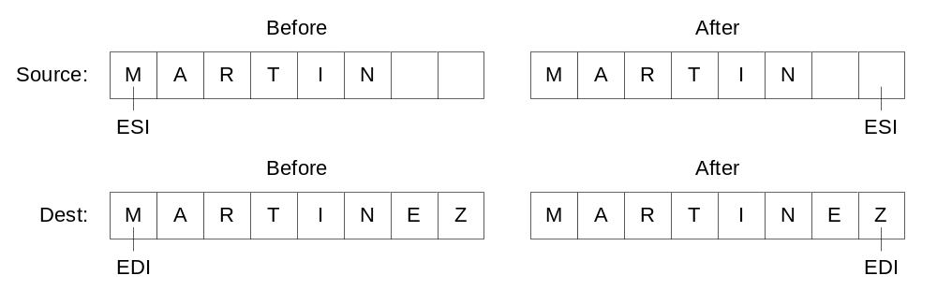
Example: Comparing Two Strings (3 of 3)
The following diagram shows the final values of ESI and EDI after comparing the strings:
Irvine, Kip R. Assembly Language for x86 Processors 7/e, 2015.

Slide 16
Your turn . . .
Modify the String Comparison program from the previous two slides. Give three possible result: Smaller, Larger, Equal.
If using
source BYTE "MARTIN”
What will happen? Smaller, Larger, or Equal?
How to change the code to make the “Equal” result happen?
Added by Zuoliu Ding, 2007.

Slide 17
SCASB, SCASW, and SCASD
The SCASB, SCASW, and SCASD instructions compare a value in AL/AX/EAX to a byte, word, or doubleword, respectively, addressed by EDI.
Useful types of searches:
  Search for a specific element in a long string or array.
  Search for the first element that does not match a given value.
Irvine, Kip R. Assembly Language for x86 Processors 7/e, 2015.

Slide 18
SCASB Example
Search for the letter 'F' in a string named alpha:
Example: ReadString in Irvine32.asm
.data
alpha BYTE "ABCDEFGH",0
.code
mov edi,OFFSET alpha
mov al,'F' ; search for 'F'
mov ecx,LENGTHOF alpha
cld
repne scasb ; repeat while not equal
jnz quit
dec edi ; EDI points to 'F'
What is the purpose of the JNZ instruction?
Irvine, Kip R. Assembly Language for x86 Processors 7/e, 2015.
Notes:
Tìm kiếm và so sánh

Slide 19
STOSB, STOSW, and STOSD
The STOSB, STOSW, and STOSD instructions store the contents of AL/AX/EAX, respectively, in memory at the offset pointed to by EDI.
Example: fill an array with 0FFh
.data
Count = 100
string1 BYTE Count DUP(?)
.code
mov al,0FFh ; value to be stored
mov edi,OFFSET string1 ; EDI points to target
mov ecx,Count ; character count
cld ; direction = forward
rep stosb ; fill with contents of AL
Irvine, Kip R. Assembly Language for x86 Processors 7/e, 2015.
Notes:
Lưu giá trị thanh gi vào edi

Slide 20
LODSB, LODSW, and LODSD
LODSB, LODSW, and LODSD load a byte or word from memory at ESI into AL/AX/EAX, respectively.
Example:
.data
array BYTE 1,2,3,4,5,6,7,8,9
.code
mov esi,OFFSET array
mov ecx,LENGTHOF array
cld
L1: lodsb ; load byte into AL
or al,30h ; convert to ASCII
call WriteChar ; display it
loop L1
Irvine, Kip R. Assembly Language for x86 Processors 7/e, 2015.

Slide 21
Array Multiplication Example
Multiply each element of a doubleword array by a constant value.
.data
array DWORD 1,2,3,4,5,6,7,8,9,10
multiplier DWORD 10
.code
cld ; direction = up
mov esi,OFFSET array ; source index
mov edi,esi ; destination index
mov ecx,LENGTHOF array ; loop counter
L1: lodsd ; copy [ESI] into EAX
mul multiplier ; multiply by a value
stosd ; store EAX at [EDI]
loop L1
Irvine, Kip R. Assembly Language for x86 Processors 7/e, 2015.

Slide 22
Your turn . . .
Write a program that converts each unpacked binary-coded decimal byte belonging to an array into an ASCII decimal byte and copies it to a new array.
.data
array BYTE 1,2,3,4,5,6,7,8,9
dest BYTE (LENGTHOF array) DUP(?)
mov esi,OFFSET array
mov edi,OFFSET dest
mov ecx,LENGTHOF array
cld
L1: lodsb ; load into AL
or al,30h ; convert to ASCII
stosb ; store into memory
loop L1
Irvine, Kip R. Assembly Language for x86 Processors 7/e, 2015.

Slide 23
What's Next
String Primitive Instructions
Selected String Procedures
Two-Dimensional Arrays
Searching and Sorting Integer Arrays
Java Bytecodes: String Processing (optional topic)
Irvine, Kip R. Assembly Language for x86 Processors 7/e, 2015.

Slide 24
Selected 32-Bit String Procedures
The following string procedures may be found in the Irvine32 library
Str_compare Procedure
Str_length Procedure
Str_copy Procedure
Str_trim Procedure
Str_ucase Procedure
Irvine, Kip R. Assembly Language for x86 Processors 7/e, 2015.

Slide 25
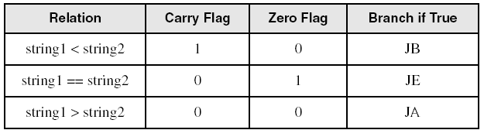
Str_compare Procedure
Compares string1 to string2, setting the Carry and Zero flags accordingly
Prototype:
Str_compare PROTO,
string1:PTR BYTE, ; pointer to string
string2:PTR BYTE ; pointer to string
Irvine, Kip R. Assembly Language for x86 Processors 7/e, 2015.

Slide 26
Str_compare Source Code
Str_compare PROC USES eax edx esi edi,
string1:PTR BYTE, string2:PTR BYTE
mov esi,string1
mov edi,string2
L1: mov al,[esi]
mov dl,[edi]
cmp al,0 ; end of string1?
jne L2 ; no
cmp dl,0 ; yes: end of string2?
jne L2 ; no
jmp L3 ; yes, exit with ZF = 1
L2: inc esi ; point to next
inc edi
cmp al,dl ; chars equal?
je L1 ; yes: continue loop
L3: ret
Str_compare ENDP
Irvine, Kip R. Assembly Language for x86 Processors 7/e, 2015.

Slide 27
Str_length Procedure
Calculates the length of a null-terminated string and returns the length in the EAX register.
Prototype:
Str_length PROTO,
pString:PTR BYTE ; pointer to string
Example:
.data
myString BYTE "abcdefg",0
.code
INVOKE Str_length,
ADDR myString
; EAX = 7
Irvine, Kip R. Assembly Language for x86 Processors 7/e, 2015.

Slide 28
Str_length Source Code
Attention: PTR BYTE and BYTE PTR
Str_length PROC USES edi,
pString:PTR BYTE ; pointer to string
mov edi,pString
mov eax,0 ; character count
L1:
cmp byte ptr [edi],0 ; end of string?
je L2 ; yes: quit
inc edi ; no: point to next
inc eax ; add 1 to count
jmp L1
L2: ret
Str_length ENDP
Irvine, Kip R. Assembly Language for x86 Processors 7/e, 2015.

Slide 29
Str_copy Procedure
Copies a null-terminated string from a source location to a target location. See CopyStr.asm
Prototype:
Str_copy PROTO,
source:PTR BYTE, ; pointer to string
target:PTR BYTE ; pointer to string
.data
string_1 BYTE "ABC",0
string_2 BYTE 10 DUP(?)
; copy string_1 to string_2
.code
INVOKE Str_copy, ADDR string_1, ADDR string_2
Modified by Zuoliu Ding, 2010.

Slide 30
Str_copy Source Code
Str_copy PROC USES eax ecx esi edi,
source:PTR BYTE, ; source string
target:PTR BYTE ; target string
INVOKE Str_length,source ; EAX = length source
mov ecx,eax ; REP count
inc ecx ; add 1 for null byte
mov esi,source
mov edi,target
cld ; direction = up
rep movsb ; copy the string
ret
Str_copy ENDP
Irvine, Kip R. Assembly Language for x86 Processors 7/e, 2015.

Slide 31
Str_trim Procedure
The Str_trim procedure removes all occurrences of a selected trailing character from a null-terminated string.
Prototype:
Str_trim PROTO,
pString:PTR BYTE, ; points to string
char:BYTE ; char to remove
Example:
.data
myString BYTE "Hello###",0
.code
INVOKE Str_trim, ADDR myString, '#'
myString = "Hello"
Irvine, Kip R. Assembly Language for x86 Processors 7/e, 2015.

Slide 32
Str_trim Procedure
Str_trim checks a number of possible cases (shown here with # as the trailing character):
  The string is empty.
  The string contains other characters followed by one or more trailing characters, as in "Hello##".
  The string contains only one character, the trailing character, as in "#"
  The string contains no trailing character, as in "Hello" or "H".
  The string contains one or more trailing characters followed by one or more nontrailing characters, as in "#H" or "###Hello".
Irvine, Kip R. Assembly Language for x86 Processors 7/e, 2015.

Slide 33
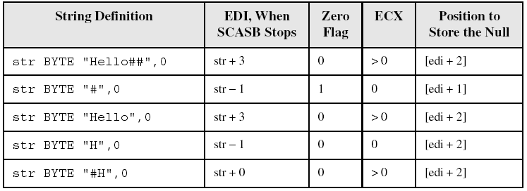
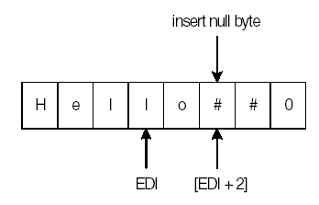
Testing the Str_trim Procedure
str
Using the first definition in the table, position of EDI when SCASB stops:
Irvine, Kip R. Assembly Language for x86 Processors 7/e, 2015.

Slide 34
Str_trim Source Code
Str_trim PROC USES eax ecx edi,
pString:PTR BYTE, ; points to string
char:BYTE ; char to remove
mov edi,pString
INVOKE Str_length,edi ; returns length in EAX
cmp eax,0 ; zero-length string?
je L2 ; yes: exit
mov ecx,eax ; no: counter = string length
dec eax
add edi,eax ; EDI points to last char
mov al,char ; char to trim
std ; direction = reverse
repe scasb ; skip past trim character
jne L1 ; removed first character?
dec edi ; adjust EDI: ZF=1 && ECX=0
L1: mov BYTE PTR [edi+2],0 ; insert null byte
L2: ret
Str_trim ENDP
See text P341 for manual search without using REPE SCASB
Irvine, Kip R. Assembly Language for x86 Processors 7/e, 2015.

Slide 35
Str_ucase Procedure
The Str_ucase procedure converts a string to all uppercase characters. It returns no value.
Prototype:
Str_ucase PROTO,
pString:PTR BYTE ; pointer to string
Example:
.data
myString BYTE "Hello",0
.code
INVOKE Str_ucase,
ADDR myString
Irvine, Kip R. Assembly Language for x86 Processors 6/e, 2010.

Slide 36
Str_ucase Source Code
Str_ucase PROC USES eax esi, pString:PTR BYTE
mov esi,pString
L1: mov al,[esi] ; get char
cmp al,0 ; end of string?
je L3 ; yes: quit
cmp al,'a' ; below "a"?
jb L2
cmp al,'z' ; above "z"?
ja L2
and BYTE PTR [esi],11011111b ; convert the char
L2: inc esi ; next char
jmp L1
L3: ret
Str_ucase ENDP
Irvine, Kip R. Assembly Language for x86 Processors 7/e, 2015.

Slide 37
String Procedures in the Irvine64 Library
Str_compare – compares two strings pointed to by RSI and RDI. Sets the Carry and Zero flags in the same manner as the CMP instruction
Str_copy – copies a source string to a location identified by a target pointer
Str_length – returns the length of a null-terminated string
Irvine, Kip R. Assembly Language for x86 Processors 7/e, 2015.

Slide 38
Example: 64-Bit Str_length
Gets the length of a string. Receives: RCX points to the string. Returns length of string in RAX.
Str_length PROC USES rdi
mov rdi,rcx ; get pointer
mov eax,0 ; character counter
L1:
cmp BYTE PTR [rdi],0 ; end of string?
je L2 ; yes: quit
inc rdi ; no: point to next
inc rax ; add 1 to count
jmp L1
L2: ret ; return count in RAX
Str_length ENDP
Irvine, Kip R. Assembly Language for x86 Processors 7/e, 2015.

Slide 39
What's Next
String Primitive Instructions
Selected String Procedures
Two-Dimensional Arrays
Searching and Sorting Integer Arrays
Java Bytecodes: String Processing (optional topic)
Irvine, Kip R. Assembly Language for x86 Processors 7/e, 2015.

Slide 40
Two-Dimensional Arrays
Row-Major (Column-Major) Order
Base-Index Operands
Base-Index Displacement
Irvine, Kip R. Assembly Language for x86 Processors 7/e, 2015.

Slide 41
Base-Index Operand
A base-index operand adds the values of two registers (called base and index), producing an effective address. Any two 32-bit general-purpose registers may be used. (Note: esp is not a general-purpose register)
  In 64-bit mode, you use 64-bit registers for bases and indexes
Base-index operands are great for accessing arrays of structures. (A structure groups together data under a single name. )
Irvine, Kip R. Assembly Language for x86 Processors 7/e, 2015.

Slide 42
Structure Application
A common application of base-index addressing has to do with addressing arrays of structures (Chapter 10). The following defines a structure named COORD containing X and Y screen coordinates:
COORD STRUCT
X WORD ? ; offset 00
Y WORD ? ; offset 02
COORD ENDS
Then we can define an array of COORD objects:
.data
setOfCoordinates COORD 10 DUP(<>)
Irvine, Kip R. Assembly Language for x86 Processors 7/e, 2015.

Slide 43
Structure Application
The following code loops through the array and displays each Y-coordinate:
mov ebx,OFFSET setOfCoordinates
mov esi,2 ; offset of Y value
mov eax,0
L1: mov ax,[ebx+esi]
call WriteDec
add ebx,SIZEOF COORD
loop L1
Irvine, Kip R. Assembly Language for x86 Processors 7/e, 2015.

Slide 44
Base-Index-Displacement Operand
A base-index-displacement operand adds base and index registers to a constant, producing an effective address. Any two 32-bit general-purpose register can be used.
Common formats:
[ base + index + displacement ]
displacement [ base + index ]
Irvine, Kip R. Assembly Language for x86 Processors 7/e, 2015.

Slide 45
64-bit Base-Index-Displacement Operand
A 64-bit base-index-displacement operand adds base and index registers to a constant, producing a 64-bit effective address. Any two 64-bit general-purpose registers can be used.
Common formats:
[ base + index + displacement ]
displacement [ base + index ]
Irvine, Kip R. Assembly Language for x86 Processors 7/e, 2015.

Slide 46
Two-Dimensional Table Example
Imagine a table with three rows and five columns. The data can be arranged in any format on the page:
table1 BYTE 10h,20h,30h,40h,50h,60h,70h,
80h,90h,0A0h,
0B0h,0C0h,0D0h,
0E0h,0F0h
NumCols = 5
table BYTE 10h, 20h, 30h, 40h, 50h
ROWSIZE = ($- table)
BYTE 60h, 70h, 80h, 90h, 0A0h
BYTE 0B0h, 0C0h, 0D0h, 0E0h, 0F0h
ROWSIZE = 5 NUMROWS = 3
Array2 WORD NUMROWS DUP( ROWSIZE DUP(0ffh) )
Irvine, Kip R. Assembly Language for x86 Processors 6/e, 2010.

Slide 47
Two-Dimensional Table Example (32-bit)
The following code loads the table element stored in row 1, column 2:
RowNum = 1
ColumnNumber = 2
mov ebx, ROWSIZE * RowNum
mov esi,ColumnNumber
mov al,table[ebx + esi]
RowNum = 1
ColumnNumber = 2
mov ebx, OFFSET table
add ebx, ROWSIZE * RowNum
mov esi,ColumnNumber
mov al,[ebx + esi*TYPE BYTE]
Another way: [base +index +displacement] as [table + ebx + esi]
Irvine, Kip R. Assembly Language for x86 Processors 6/e, 2010.

Slide 48
Two-Dimensional Table Example (64-bit)
The following 64-bit code loads the table element stored in row 1, column 2:
RowNumber = 1
ColumnNumber = 2
mov rbx,NumCols * RowNumber
mov rsi,ColumnNumber
mov al,table[rbx + rsi]
table[rbx]
table[rbx + rsi]
Irvine, Kip R. Assembly Language for x86 Processors 7/e, 2015.

Slide 49
Example: Row Sum
calc_row_sum PROC uses ebx ecx edx esi
; Receives: EBX = table offset, EAX = row index,
; ECX = row size, in bytes.
; Returns: EAX holds the sum.
mul ecx ; row index * row size
add ebx,eax ; row offset
mov eax,0 ; accumulator
mov esi,0 ; column index
L1: movzx edx,BYTE PTR[ebx + esi] ; get a byte
add eax,edx ; add to
inc esi ; next byte in row
loop L1
ret
calc_row_sum ENDP
Irvine, Kip R. Assembly Language for Intel-Based Computers 5/e, 2007.

Slide 50
What's Next
String Primitive Instructions
Selected String Procedures
Two-Dimensional Arrays
Searching and Sorting Integer Arrays
Java Bytecodes: String Processing (optional topic)
Irvine, Kip R. Assembly Language for x86 Processors 7/e, 2015.

Slide 51
Searching and Sorting Integer Arrays
Bubble Sort
  A simple sorting algorithm that works well for small arrays
Binary Search
  A simple searching algorithm that works well for large arrays of values that have been placed in either ascending or descending order
Irvine, Kip R. Assembly Language for x86 Processors 7/e, 2015.

Slide 52
Bubble Sort
Each pair of adjacent values is compared, and exchanged if the values are not ordered correctly:
Irvine, Kip R. Assembly Language for x86 Processors 7/e, 2015.

Slide 53
Bubble Sort Pseudocode
N = array size, cx1 = outer loop counter, cx2 = inner loop counter:
cx1 = N - 1
while( cx1 > 0 )
{
esi = addr(array)
cx2 = cx1
while( cx2 > 0 )
{
if( array[esi] < array[esi+4] )
exchange( array[esi], array[esi+4] )
add esi,4
dec cx2
}
dec cx1
}
Irvine, Kip R. Assembly Language for x86 Processors 7/e, 2015.

Slide 54
Bubble Sort Implementation
BubbleSort PROC USES eax ecx esi,
pArray:PTR DWORD,Count:DWORD
mov ecx,Count
dec ecx ; decrement count by 1
L1: push ecx ; save outer loop count
mov esi,pArray ; point to first value
L2: mov eax,[esi] ; get array value
cmp [esi+4],eax ; compare a pair of values
jge L3 ; if [esi] <= [edi], skip
xchg eax,[esi+4] ; else exchange the pair
mov [esi],eax
L3: add esi,4 ; move both pointers forward
loop L2 ; inner loop
pop ecx ; retrieve outer loop count
loop L1 ; else repeat outer loop
L4: ret
BubbleSort ENDP
Irvine, Kip R. Assembly Language for x86 Processors 7/e, 2015.

Slide 55
Binary Search
Searching algorithm, well-suited to large ordered data sets
Divide and conquer strategy
Each "guess" divides the list in half
Classified as an O(log n) algorithm:
  As the number of array elements increases by a factor of n, the average search time increases by a factor of log n.
Irvine, Kip R. Assembly Language for x86 Processors 7/e, 2015.

Slide 56
Binary Search Analysis
a[0], a[1], …, ..................., …, a[n-2], a[n-1]
a[0], a[1], …, a[m-1], a[m], a[m+1] …, a[n-2], a[n-1]
first
m=(first+last)/2
last
a[m]== value
Success
a[m]>value
a[m]<value
a[0],.......,a[m-1]
a[m+1],.......,a[n-1]
first
last= m-1
first= m+1
last
What is the failed condition: No value found in the array?
When the iteration finishes?
first > last
Result expected:
if found, get an index of the search value; if not found, back -1 as a failed flag

Slide 57
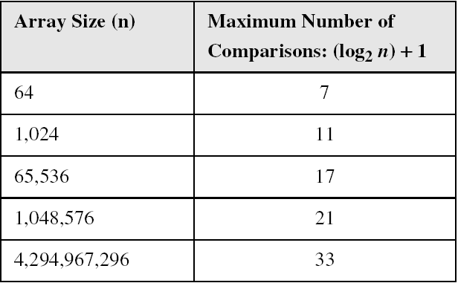
Sample Binary Search Estimates
Irvine, Kip R. Assembly Language for x86 Processors 7/e, 2015.

Slide 58
Binary Search Pseudocode
int BinSearch( int values[],
const int searchVal, int count )
{
int first = 0;
int last = count - 1;
while( first <= last )
{
int mid = (last + first) / 2;
if( values[mid] < searchVal )
first = mid + 1;
else if( values[mid] > searchVal )
last = mid - 1;
else
return mid; // success
}
return -1; // not found
}
Irvine, Kip R. Assembly Language for x86 Processors 7/e, 2015.

Slide 59
Binary Search Implementation (1 of 3)
BinarySearch PROC uses ebx edx esi edi,
pArray:PTR DWORD, ; pointer to array
Count:DWORD, ; array size
searchVal:DWORD ; search value
LOCAL first:DWORD, ; first position
last:DWORD, ; last position
mid:DWORD ; midpoint
mov first,0 ; first = 0
mov eax,Count ; last = (count - 1)
dec eax
mov last,eax
mov edi,searchVal ; EDI = searchVal
mov ebx,pArray ; EBX points to the array
L1: ; while first <= last
mov eax,first
cmp eax,last
jg L5 ; exit search
Irvine, Kip R. Assembly Language for x86 Processors 7/e, 2015.

Slide 60
Binary Search Implementation (2 of 3)
; mid = (last + first) / 2
mov eax,last
add eax,first
shr eax,1
mov mid,eax
; EDX = values[mid]
mov esi,mid
shl esi,2 ; scale mid value by 4
mov edx,[ebx+esi] ; EDX = values[mid]
; if ( EDX < searchval(EDI) )
; first = mid + 1;
cmp edx,edi
jge L2
mov eax,mid ; first = mid + 1
inc eax
mov first,eax
jmp L4 ; continue the loop
base-index addressing
Irvine, Kip R. Assembly Language for x86 Processors 7/e, 2015.

Slide 61
Binary Search Implementation (3 of 3)
; else if( EDX > searchVal(EDI) )
; last = mid - 1;
L2: cmp edx,edi ; (could be removed)
jle L3
mov eax,mid ; last = mid - 1
dec eax
mov last,eax
jmp L4 ; continue the loop
; else return mid
L3: mov eax,mid ; value found
jmp L9 ; return (mid)
L4: jmp L1 ; continue the loop
L5: mov eax,-1 ; search failed
L9: ret
BinarySearch ENDP
Irvine, Kip R. Assembly Language for x86 Processors 7/e, 2015.

Slide 62
What's Next
String Primitive Instructions
Selected String Procedures
Two-Dimensional Arrays
Searching and Sorting Integer Arrays
Java Bytecodes: String Processing (optional topic)
Irvine, Kip R. Assembly Language for x86 Processors 7/e, 2015.

Slide 63
Java Bytecodes: String Processing
In Java, strings identifiers are references to other storage
  think of a reference as a pointer, or address
Ways to load and store a string:
  ldc - loads a reference to a string literal from the constant pool
  astore - pops a string reference from the stack and stores it in a local variable
Irvine, Kip R. Assembly Language for x86 Processors 7/e, 2015.

Slide 64
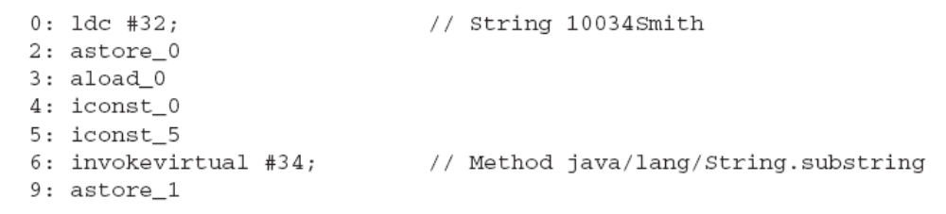
String Processing Example
Java:
  String empInfo = "10034Smith";
  String id = empInfo.substring(0,5);
Bytecode disassembly:
invokevirtual calls a class method
Irvine, Kip R. Assembly Language for x86 Processors 7/e, 2015.

Slide 65
Summary
String primitives are optimized for efficiency
Strings and arrays are essentially the same
Keep code inside loops simple
Use base-index operands with two-dimensional arrays
Avoid the bubble sort for large arrays
Use binary search for large sequentially ordered arrays
Irvine, Kip R. Assembly Language for x86 Processors 7/e, 2015.

Slide 66
45 6E 64 65
Irvine, Kip R. Assembly Language for x86 Processors 7/e, 2015.

